Slide 1
AVIATION STRATEGY AND RISK EVASION

Slide 2
INTRODUCTION:aviation-business-strategy-and-risk-evasion-
This project embarks on a comprehensive analysis of the Aviation Accident Database & Synopses, spanning six decades from 1963 to 2023. By leveraging this extensive dataset, our goal is to extract valuable business insights that will strategically guide our company’s entry into the aviation industry, thereby diversifying our portfolio. This in-depth analysis will not only uncover trends and patterns in aviation safety but also identify promising opportunities for innovation and growth within the sector, positioning us for success in the dynamic world of aviation.

Slide 3
MAIN OBJECTIVES:

Slide 4
The primary aim of this project is to leverage historical data from the Aviation Accident Database & Synopses, covering the period from 1963 to 2023, to derive strategic business insights. These insights will guide our company's entry into the aviation industry, ensuring informed decision-making and risk management. The specific objectives of this analysis are:
1.Identify the Optimal Aircraft Type:
Goal: Determine the best aircraft type for the company to invest in, based on safety records, operational efficiency, and profitability.
2.Seasonal Risk Assessment:
Goal: Analyze seasonal variations in aviation incidents to identify the safest and most favorable seasons for operational activities.
3Optimal Location for Operations:
Goal: Evaluate different geographical locations to pinpoint the best overall location for establishing operations, considering incident rates and operational conditions.
4Phase of Flight Risk Analysis:
Goal: Assess the risk associated with different phases of flight to identify the most hazardous phases and develop strategies to mitigate these risks.
5Weather Condition Analysis:
Goal: Ascertain the ideal weather conditions for safe operations and understand how different weather scenarios impact aviation safety.
6Human Risk Evaluation:
Goal: Determine which aircraft types pose the greatest risk to human life, guiding safety measures and investment decisions.
7Business Recommendations:
Goal: Formulate actionable business recommendations based on the comprehensive analysis to support the company’s strategic planning and growth in the aviation sector.

Slide 5
Data ANALYSIS:

Slide 6
This were the methods used while cleaning and analysing the data in order to give clean accurate insights:
1.Data Cleaning:
Removed unnecessary columns and handled missing values to ensure a clean and workable dataset.
Standardized data formats and categorized information where necessary.
2.Feature Selection:
Selected relevant features that provide meaningful insights for the analysis, dropping irrelevant columns.
Conducted correlation analysis to identify relationships between variables.
3.Aggregation and Grouping:
Grouped data by relevant categories (e.g., Aircraft Type, Season, Location) to facilitate targeted analysis.
Reclassified categories and aggregated data to align with specific business objectives.
4.Visualization Techniques:
Utilized visualization tools such as bar charts, line charts, heatmaps, and scatter plots to represent data visually.
Generated visualizations to identify patterns, trends, and outliers, supporting data-driven conclusions.

Slide 7
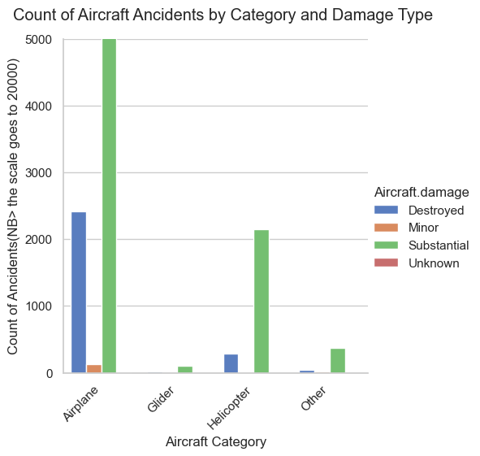
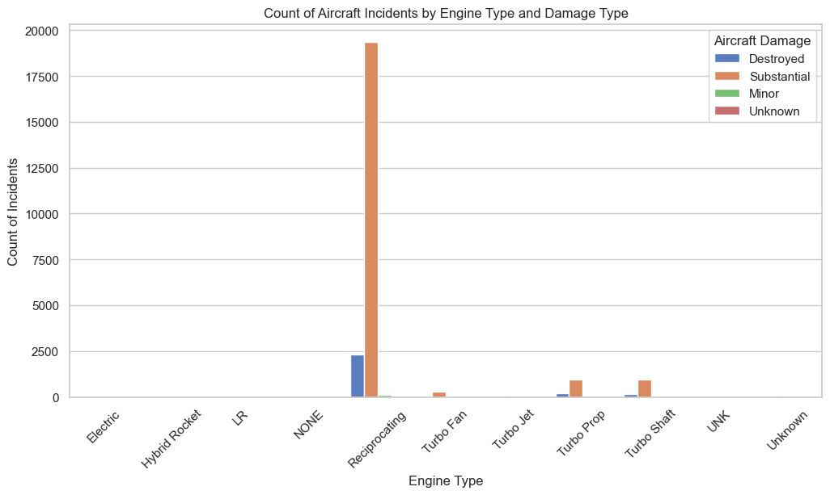
1. Aircraft Type analysis
The graphs illustrate the count of incidents by aircraft category and engine type. Key takeaways include:
Airplane Incident Frequency:
Airplanes are more prone to accidents compared to other types of aircraft.
Engine Type Risk:
Aircraft equipped with reciprocating engines show a higher inclination towards incidents, highlighting a significant risk factor for these engine types.

Slide 8
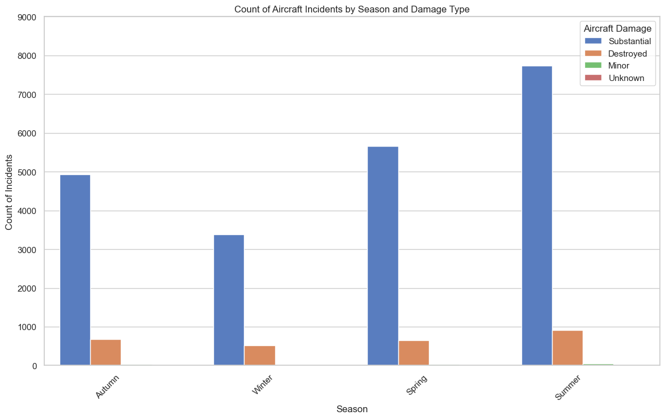
2. Seasonal Analysis
Aircraft Incidents by Season:
The number of planes destroyed remains relatively constant across all seasons, indicating that certain types of damage are not heavily influenced by seasonal variations.
Increased Risk in Summer:
There is a notable increase in incidents during the summer, suggesting that flying conditions or operational factors in this season may contribute to higher risk.
Winter Operations for Planes:
Lower incident rates during winter.

Slide 9
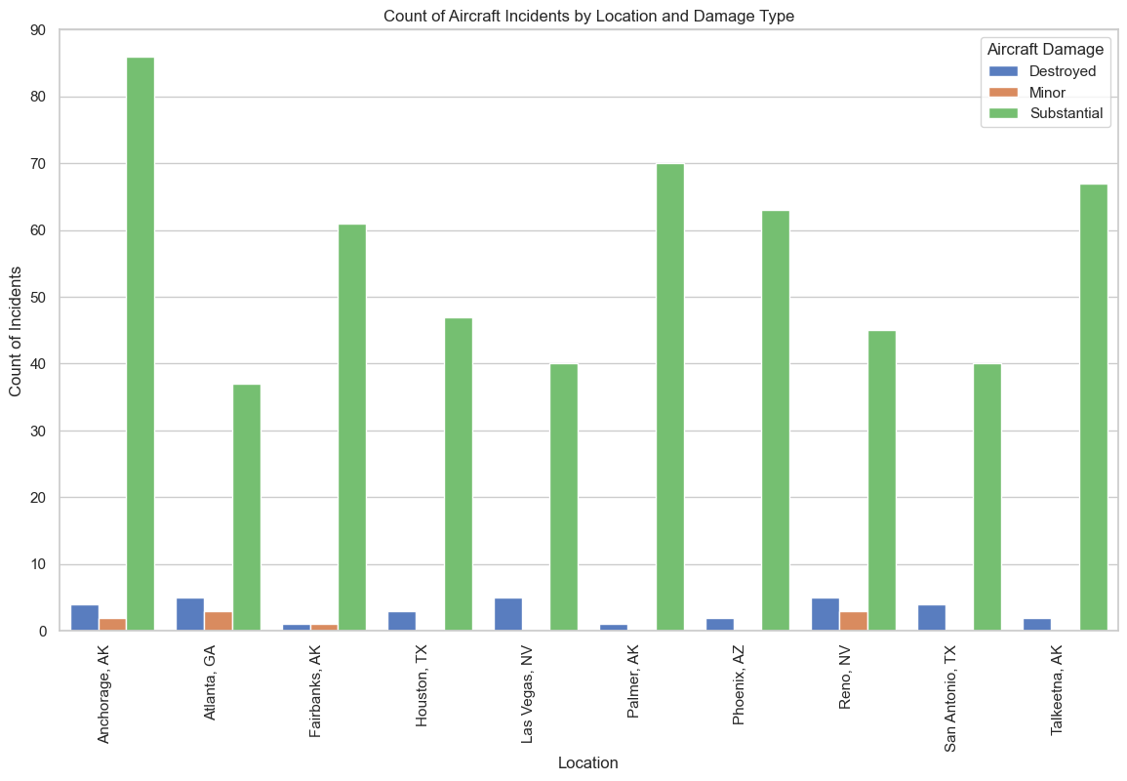
3.Location Analysis
Based on the graph of Count of Aircraft Incidents by Location and Damage Type for the top 10 airports, I identified the top 3 locations with incident counts below 40:
.Atlanta
.las Vegas
.San Antonio

Slide 10
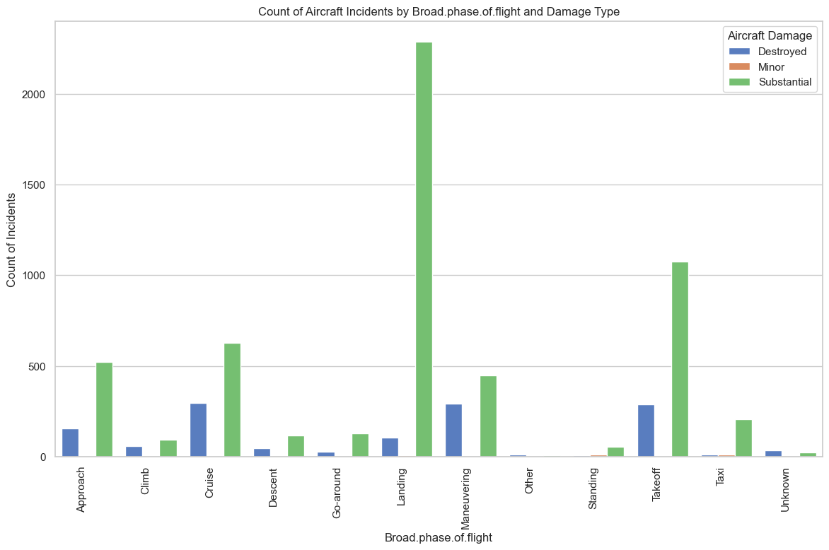
4.Phase of Flight Risk Analysis
Risk Assessment by Flight Phase:
Analysis of the graph showing the Count of Aircraft Incidents by Broad Phase of Flight and Damage Type reveals that the landing and takeoff phases pose the highest risk.

Slide 11
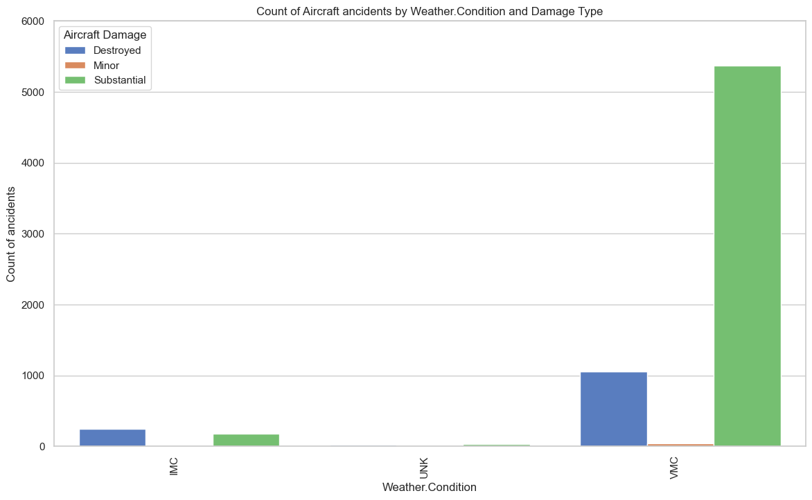
5.Weather Condition Analysis
The graph of Count of Aircraft Incidents by Weather Condition and Damage Type highlights that Visual Meteorological Conditions (VMC) are associated with the highest number of incidents.

Slide 12
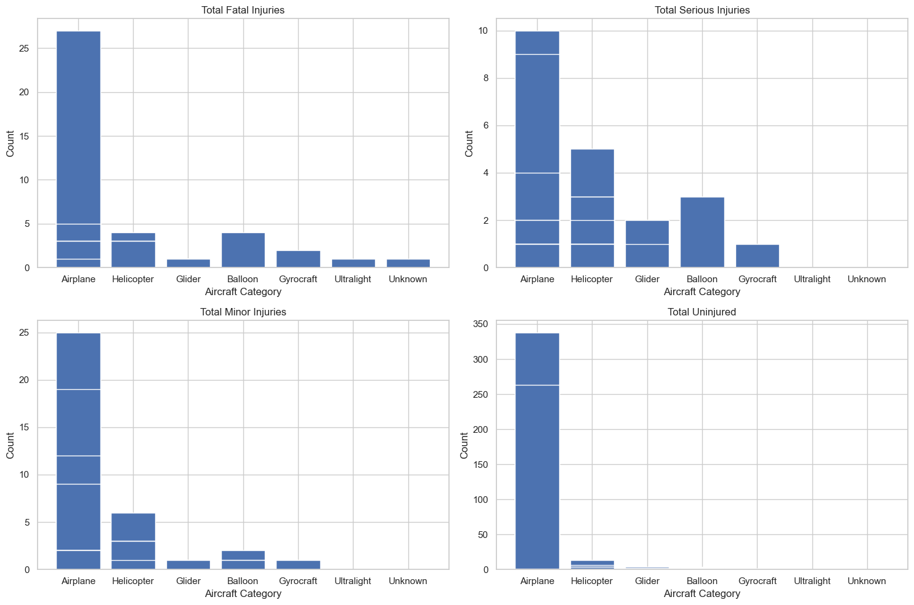
6. Human Risk Analysis
The analysis of the graphs reveals that airplanes have the highest number of injured people. However, they also account for the highest number of uninjured individuals. This duality indicates that while airplanes are involved in more incidents, a significant proportion of these incidents result in no injuries.

Slide 13
Concrete Business Aviation Recommendations

Slide 14
Based on the thorough analysis of the aviation data, here are the strategic recommendations:

Slide 15
1.Initial Focus on Lightweight Crafts:
Start operations with lightweight aircraft such as gliders, ultralights, and powered parachutes. These types have shown lower incident rates, providing a safer entry into the market.
2.Gradual Expansion:
Once safe and efficient operations are established with lightweight crafts, gradually expand to larger aircraft. This phased approach allows for building expertise and managing risks effectively.
3.Continual Risk Assessment:
Implement ongoing monitoring and risk assessment strategies to identify and mitigate potential hazards. This helps maintain high safety standards and supports informed decision-making.
4.Training and Safety Protocols:
Invest in comprehensive training programs for pilots and crew, focusing on the unique challenges associated with different aircraft types and phases of flight.

Slide 16
5.Future Plane Investments:
If the company decides to invest in planes in the future, avoid those with reciprocating engines due to higher accident rates. Opt for aircraft with safer engine types to mitigate risks.
6.Optimal Seasonal Operations:
Light Aircraft: Focus operations in autumn for reduced risk and favorable conditions.
Planes: Prioritize winter operations for enhanced safety and minimized risk of incidents.
7.Seasonal Risk Management:
Implement stricter safety protocols and monitoring during summer months to mitigate the increased risk of incidents.
8.Recommended Locations for Startups:
Consider Atlanta, Las Vegas, and San Antonio for startups due to their relatively low incident rates. These locations offer safer operational environments, crucial for minimizing risks and ensuring smooth operations.

Slide 17
9.Airport Path Condition:
Conduct thorough and regular assessments of airport runways and taxiways to ensure optimal condition. This includes checking for potential hazards, ensuring proper maintenance, and implementing safety measures.
10.Skilled Pilot Recruitment:
Prioritize the recruitment and training of pilots who have proven expertise in handling takeoff and landing maneuvers. Implement advanced training programs and continuous skill enhancement sessions.
11.Enhanced Safety Protocols:
Develop and enforce stringent safety protocols specifically for the takeoff and landing phases. Include procedural checklists, advanced simulation training, and real-time monitoring systems to detect and respond to potential issues quickly.
12Avoid VMC for Lightweight Aircraft:
Strategically plan flight operations to avoid Visual Meteorological Conditions (VMC), especially when operating lightweight crafts. Consider alternative weather conditions for safer flights.
13Training and Preparedness:
Ensure pilots and crew are well-trained to handle various weather conditions. Place special emphasis on managing flights in non-VMC conditions to enhance overall safety.

Slide 18
conclusion Thank you for your time and attention. Your support and collaboration are key to our success as we venture into the aviation industry. Next Phase As we move forward, our next step is to gather a dataset that includes specific locations and revenue details. This data will help us further refine our analysis and develop more targeted strategies for growth and efficiency.

Slide 19
THANK YOU
Khalif Kahin
Phone:0722582570
Email:khalifkahin@gmail.com

